Slide 1
•
THE EVOLUTION OF ARTIFICIAL
INTELLIGENCE :A COMPREHENSIVE AADARSH CHAUDHARY
•

Slide 2
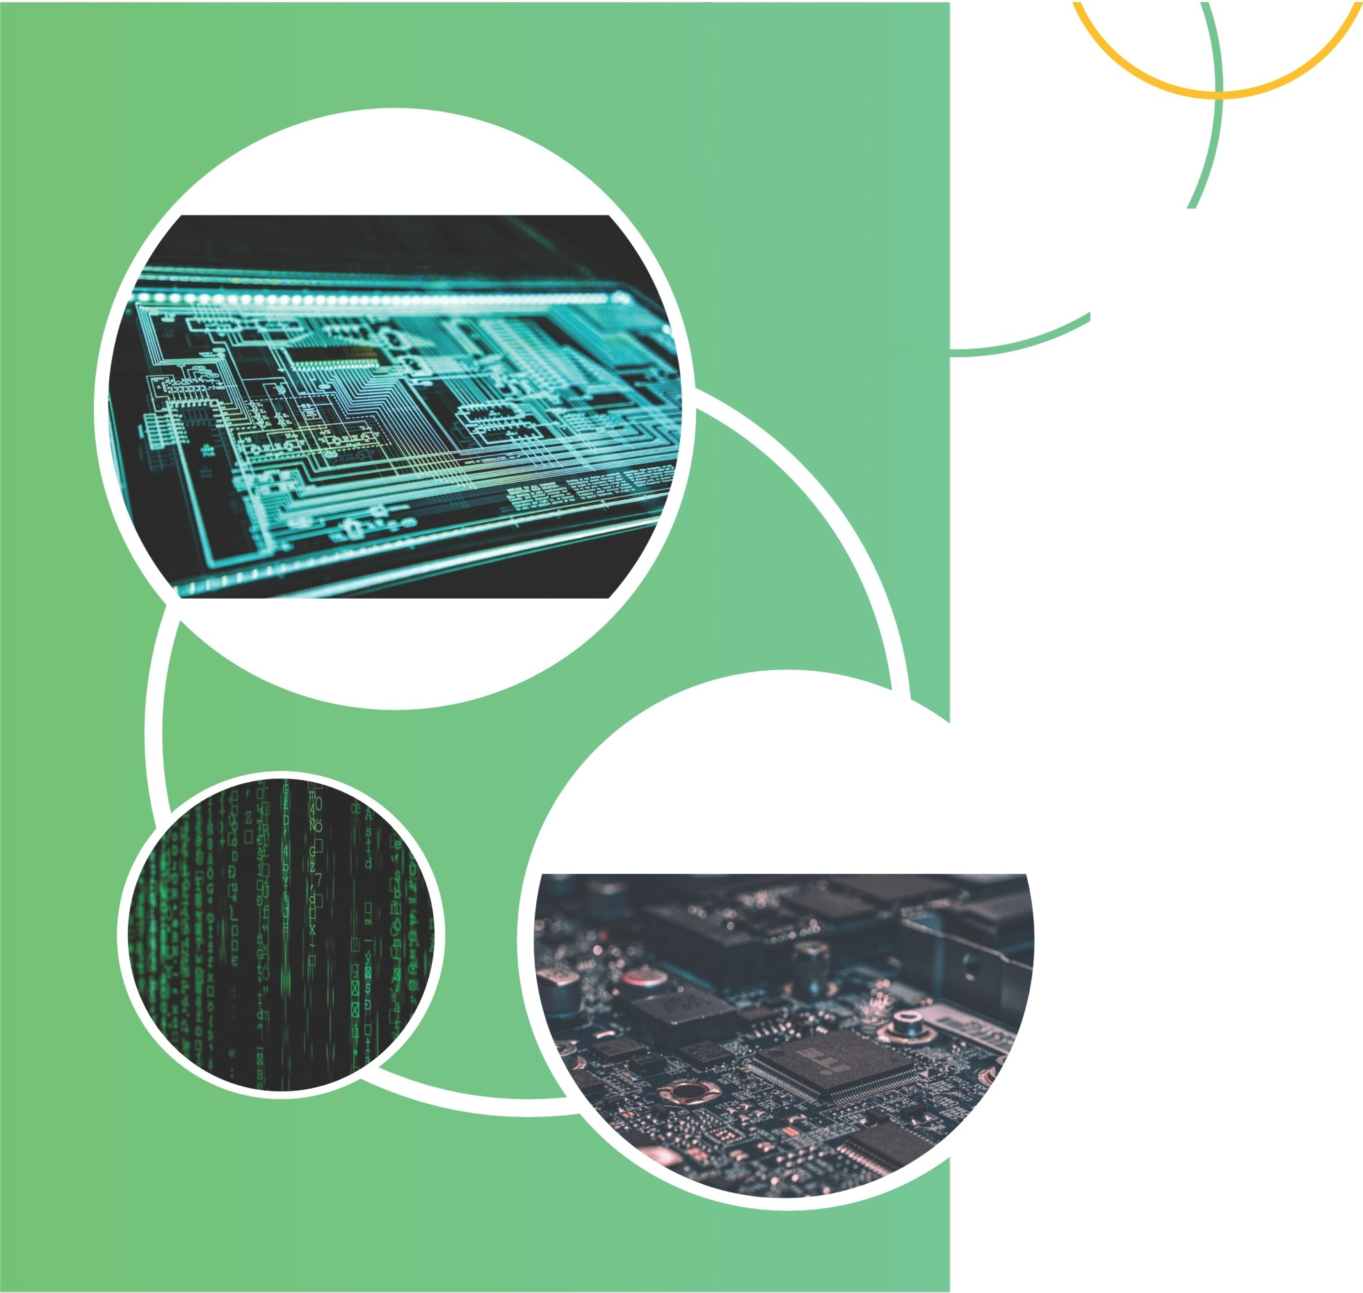
1. INTRODUCTION - WHAT IS ARTIFICIAL INTELLIGENCE?
ARTIFICIAL INTELLIGENCE (AL) HAS UNDERGONE A REMARKABLE EVOLUTION OVER THE YEARS, TRANSFORMING INDUSTRIES AND HUMAN LIVES IN UNPRECEDENTED WAYS. IN THIS COMPREHENSIVE EXPLORATION PRESENTED THROUGH 15 INSIGHTFUL SLIDES, WE DELVE INTO THE CAPTIVATING JOURNEY OF AL. FROM ITS HUMBLE
BEGINNINGS TO ITS CURRENT STATE OF ADVANCED MACHINE LEARNING ALGORITHMS AND COMPLEX NEURAL NETWORKS, WE UNCOVER THE MILESTONES AND BREAKTHROUGHS THAT HAVE SHAPED THE WORLD OF AL.

Slide 3
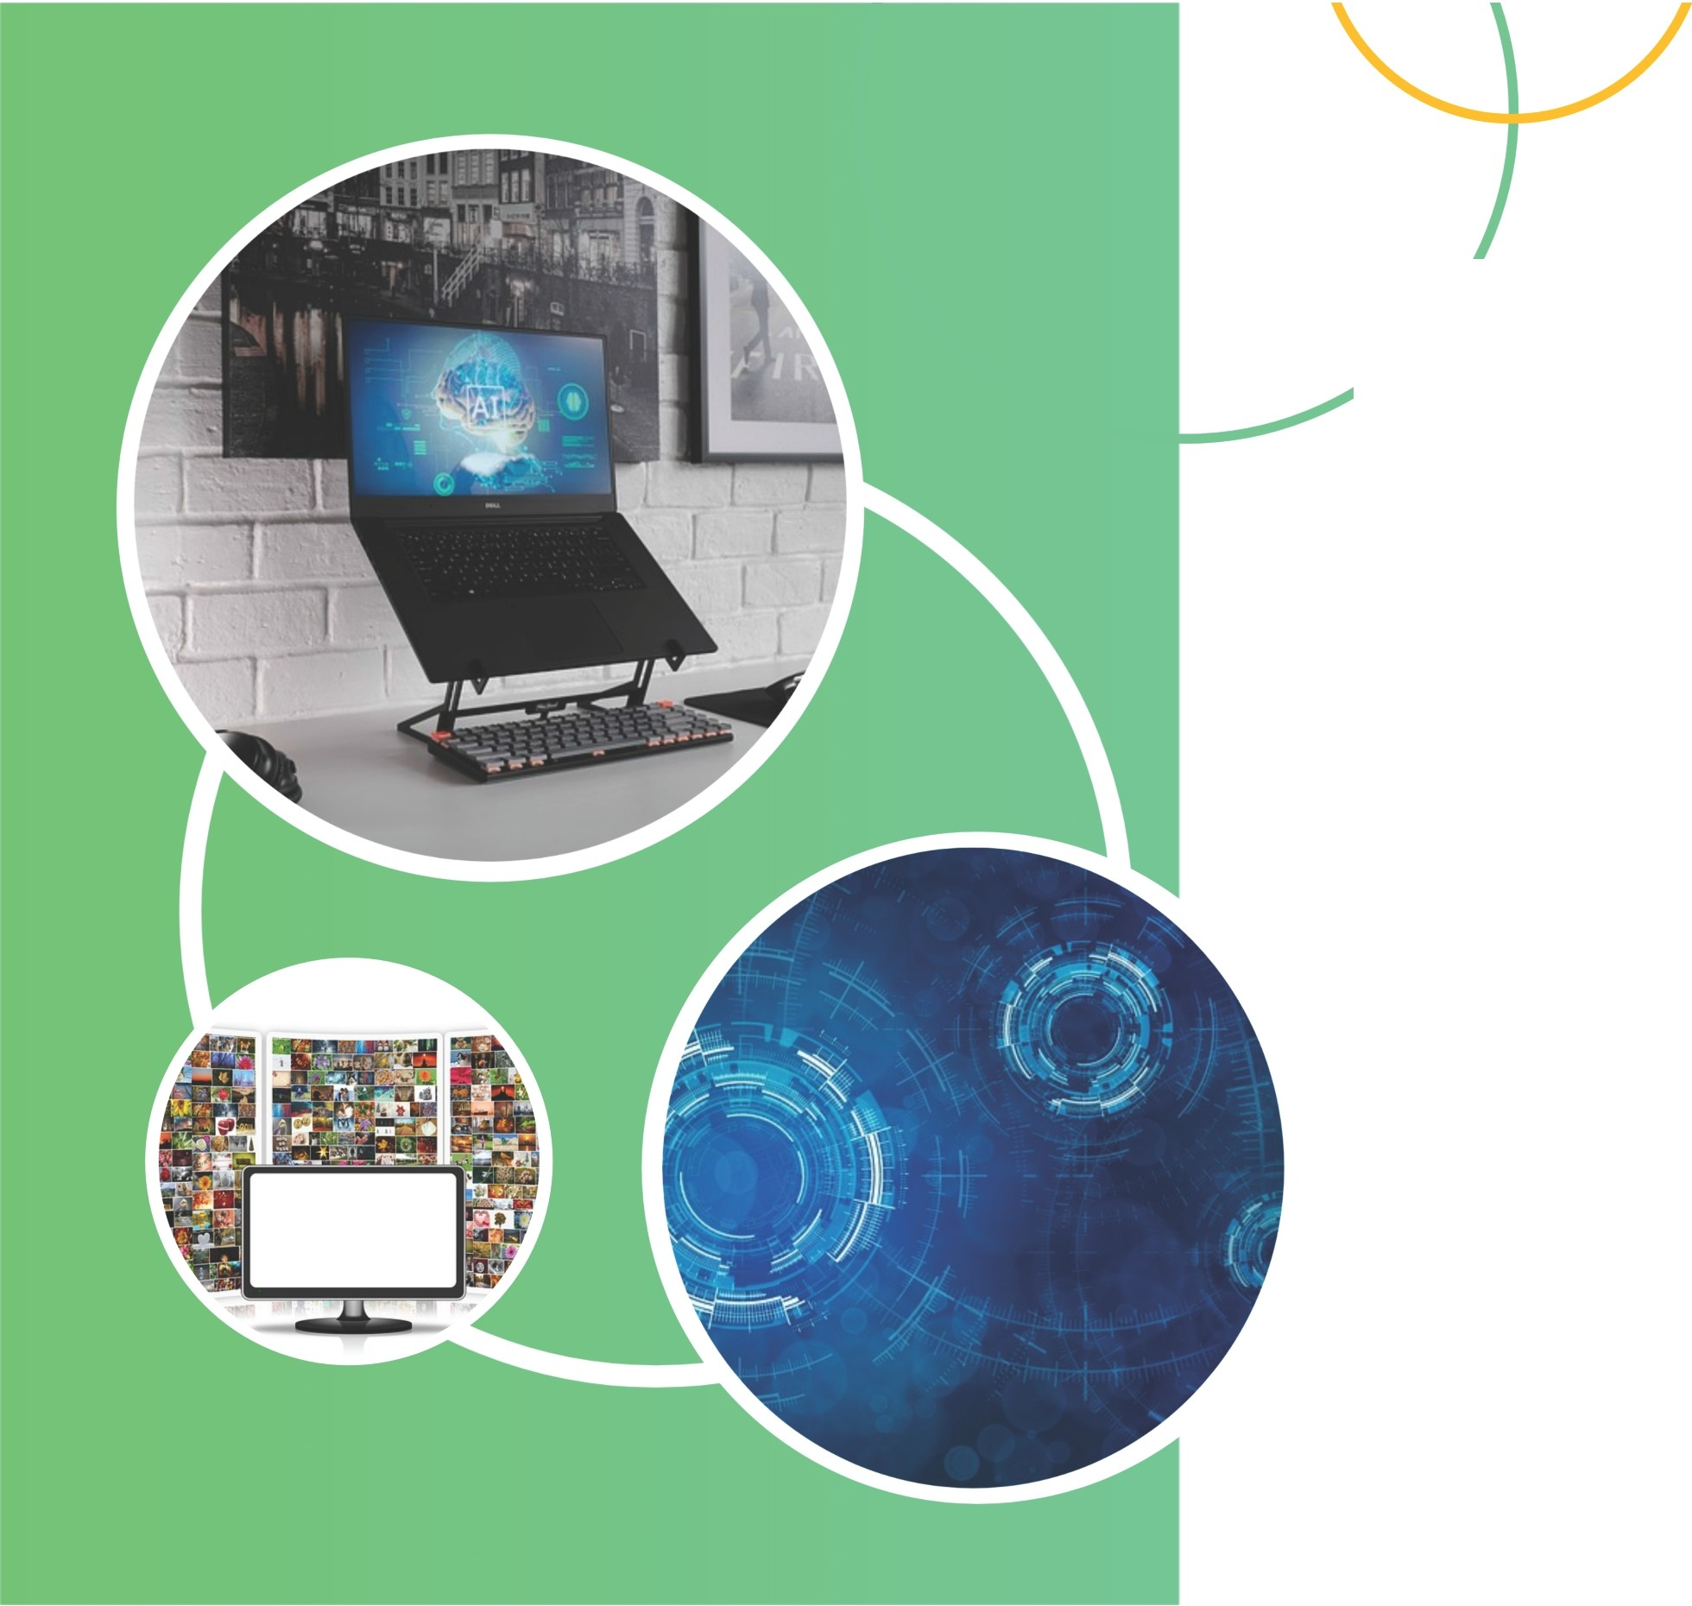
2. EARLY BEGINNINGS OF ARTIFICIAL INTELLIGENCE
THE EARLY BEGINNINGS OF ARTIFICIAL INTELLIGENCE CAN BE TRACED BACK TO THE MID- 20TH CENTURY WHEN RESEARCHERS BEGAN EXPLORING THE CONCEPT OF CREATING MACHINES THAT COULD SIMULATE HUMAN INTELLIGENCE. EARLY DEVELOPMENTS IN AL FOCUSED ON TASKS SUCH AS PROBLEM-SOLVING AND LANGUAGE TRANSLATION, PAVING THE WAY FOR FUTURE ADVANCEMENTS AND SETTING THE STAGE FOR THE TRANSFORMATIVE IMPACT AL WOULD HAVE ON VARIOUS INDUSTRIES.

Slide 4
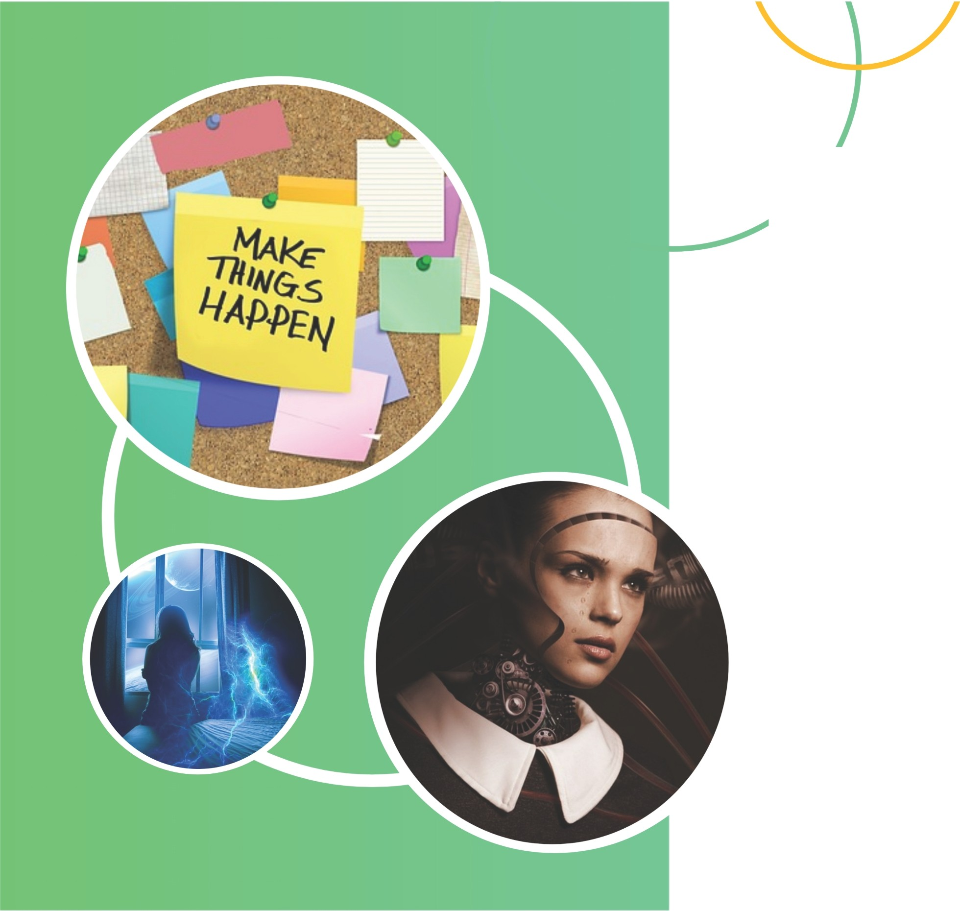
3. ADVANCEMENTS IN MACHINE LEARNING ALGORITHMS
MACHINE LEARNING ALGORITHMS HAVE PLAYED A CRUCIAL ROLE IN ADVANCING ARTIFICIAL INTELLIGENCE. FROM SIMPLE RULE-BASED ALGORITHMS TO MORE COMPLEX NEURAL NETWORKS, THESE ALGORITHMS HAVE ENABLED MACHINES TO LEARN FROM DATA, MAKE PREDICTIONS, AND IMPROVE THEIR PERFORMANCE OVER TIME. KEY ADVANCEMENTS INCLUDE DEEP LEARNING, REINFORCEMENT LEARNING, AND NATURAL LANGUAGE PROCESSING, OPENING UP NEW POSSIBILITIES FOR AL APPLICATIONS IN VARIOUS INDUSTRIES.

Slide 5
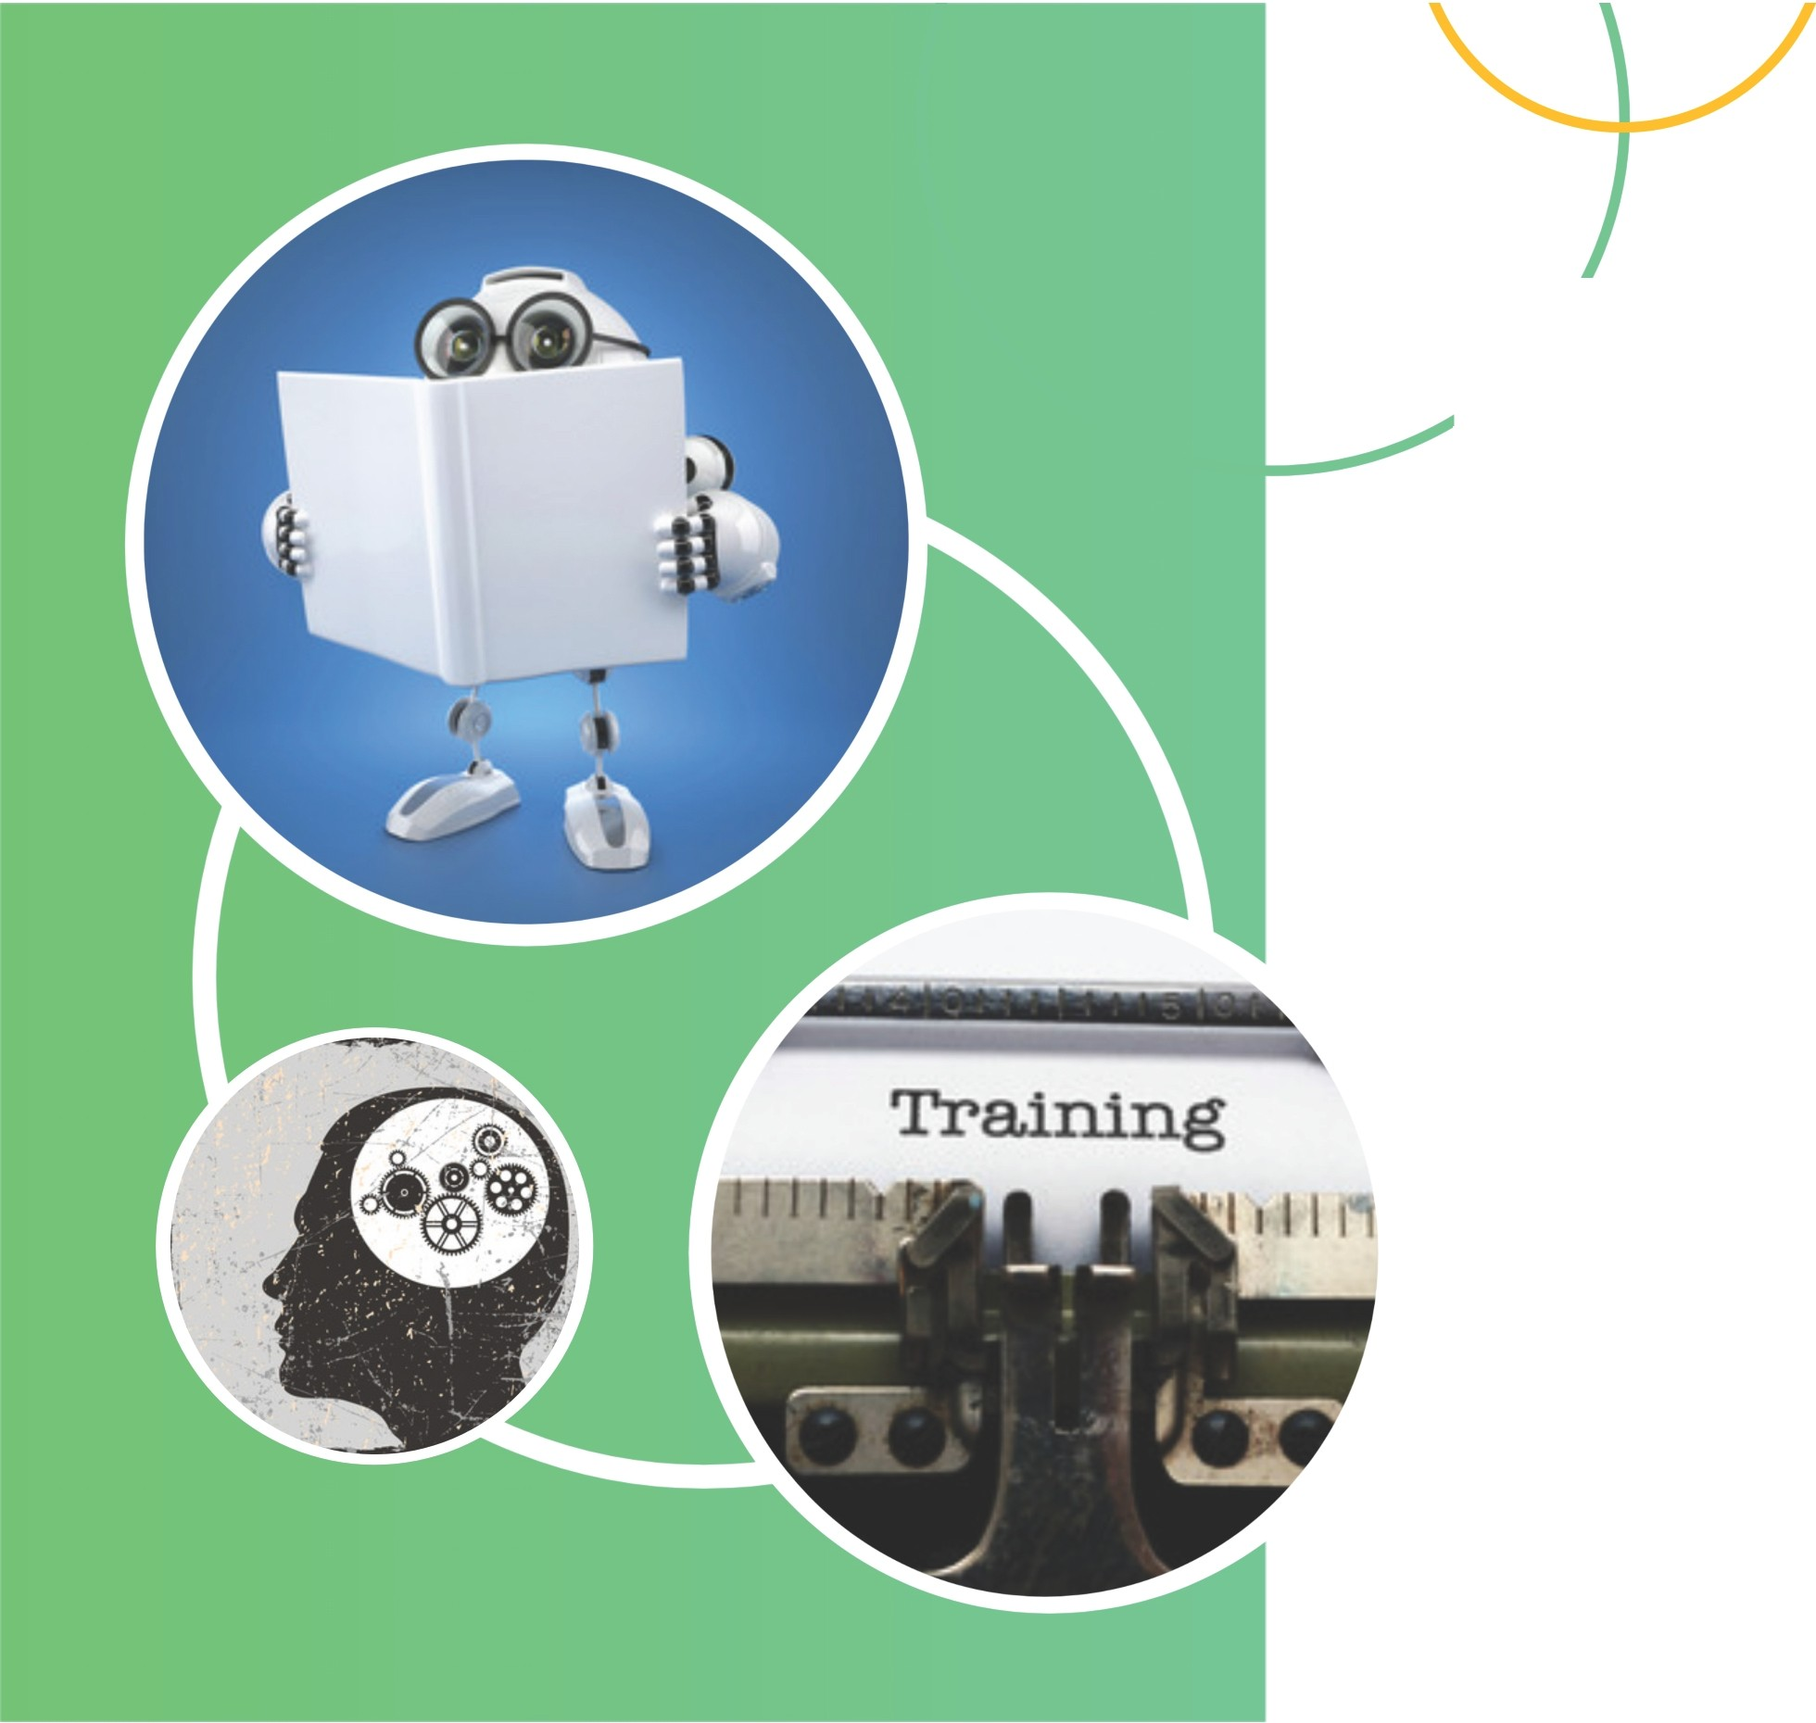
4. Deep Learning and Neural Networks
Deep learning and neural networks are revolutionizing the field of artificial intelligence. With their ability to analyze vast amounts of data and extract complex patterns, these technologies have achieved remarkable results in image recognition, speech synthesis, and language translation.
They mimic the structure of the human brain, allowing machines to learn and make decisions independently, paving the way for truly intelligent systems.

Slide 6
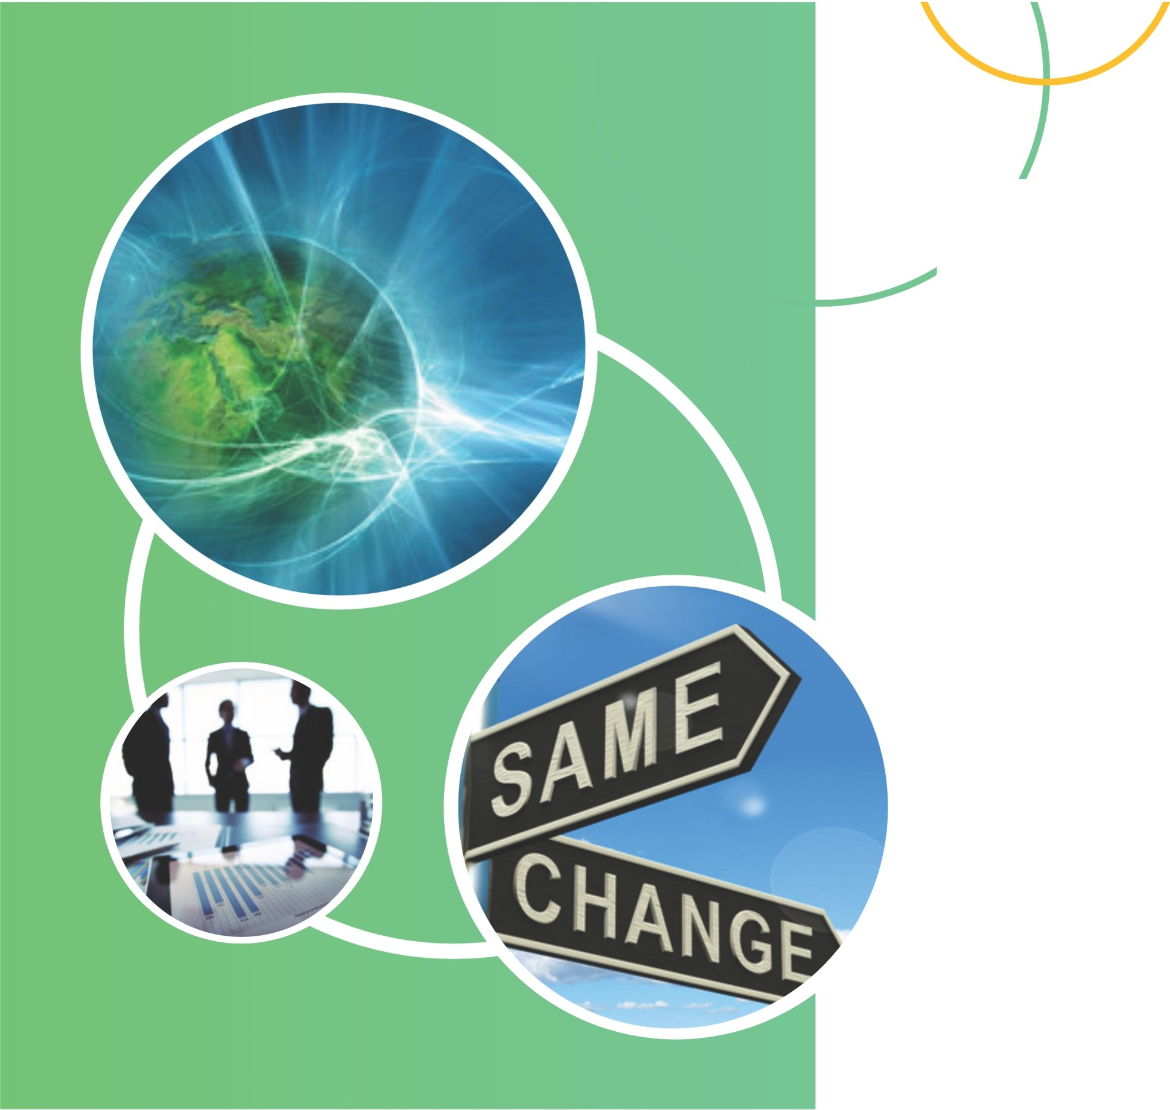
5. Natural Language Processing : From Rule-Based Systems to Deep Learning
Natural Language Processing (NLP) has significantly evolved over the years, from rule-based systems to the application of deep learning techniques . NLP enables machines to understand, analyze, and generate human language, making it possible for chatbots, virtual assistants, and voice recognition systems to communicate eff ectively. Deep learning models, such as recurrent neural networks and transformers, have improved language understanding and translation,transforming the way we interact with
Al-powered systems.

Slide 7
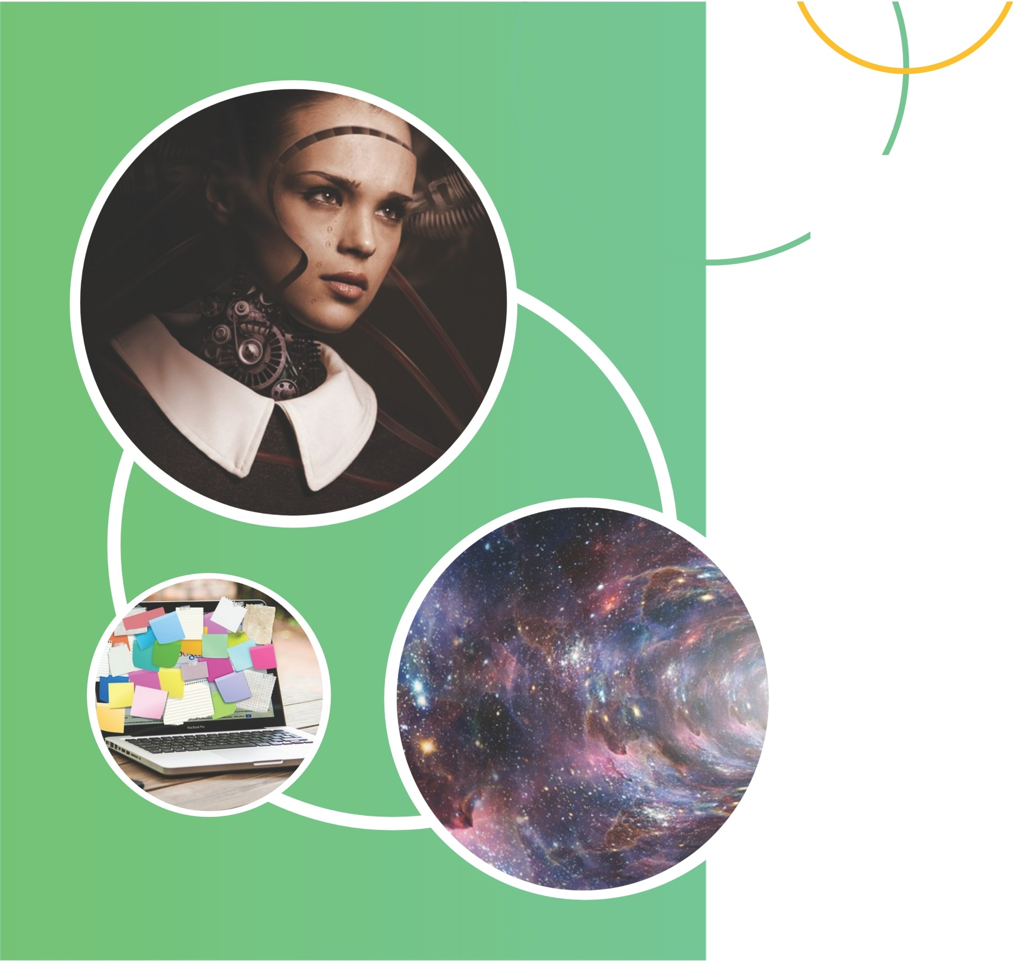
6. COMPUTER VISION:FROM IMAGE RECOGNITION TO OBJECT DETECTION
Computer vision has revolutionized the way machines understand and interpret visual data.From simple image recognition to more advanced tasks like object detection and segmentation, computer vision algorithms have significantly improved. This has led to applications in various fields, including self -driving cars, surveillance systems, and medical imaging, enhancing our ability to analyze and understand the world through Al.

Slide 8
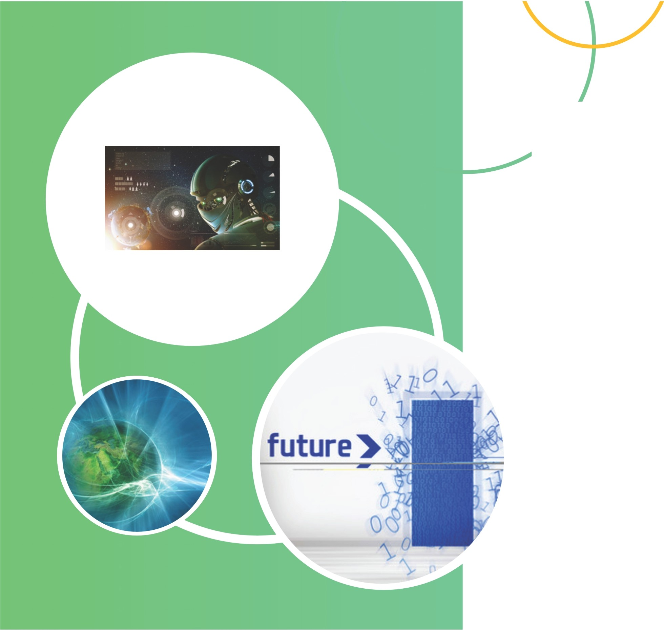
7. ROBOTICS AND ARTIFICIAL INTELLIGENCE
THE INTEGRATION OF ROBOTICS AND ARTIFICIAL INTELLIGENCE HAS OPENED UP COUNTLESS POSSIBILITIES ACROSS INDUSTRIES. FROM AUTOMATED MANUFACTURING PROCESSES TO INTELLIGENT ROBOTIC ASSISTANTS, AL-POWERED ROBOTS ARE TRANSFORMING THE WAY WE WORK AND INTERACT. THESE ADVANCEMENTS HAVE THE POTENTIAL TO IMPROVE EFFICIENCY, PRODUCTIVITY, AND EVEN ENHANCE HUMAN CAPABILITIES, WHILE ALSO POSING ETHICAL AND SOCIETAL CHALLENGES THAT MUST BE ADDRESSED.

Slide 9
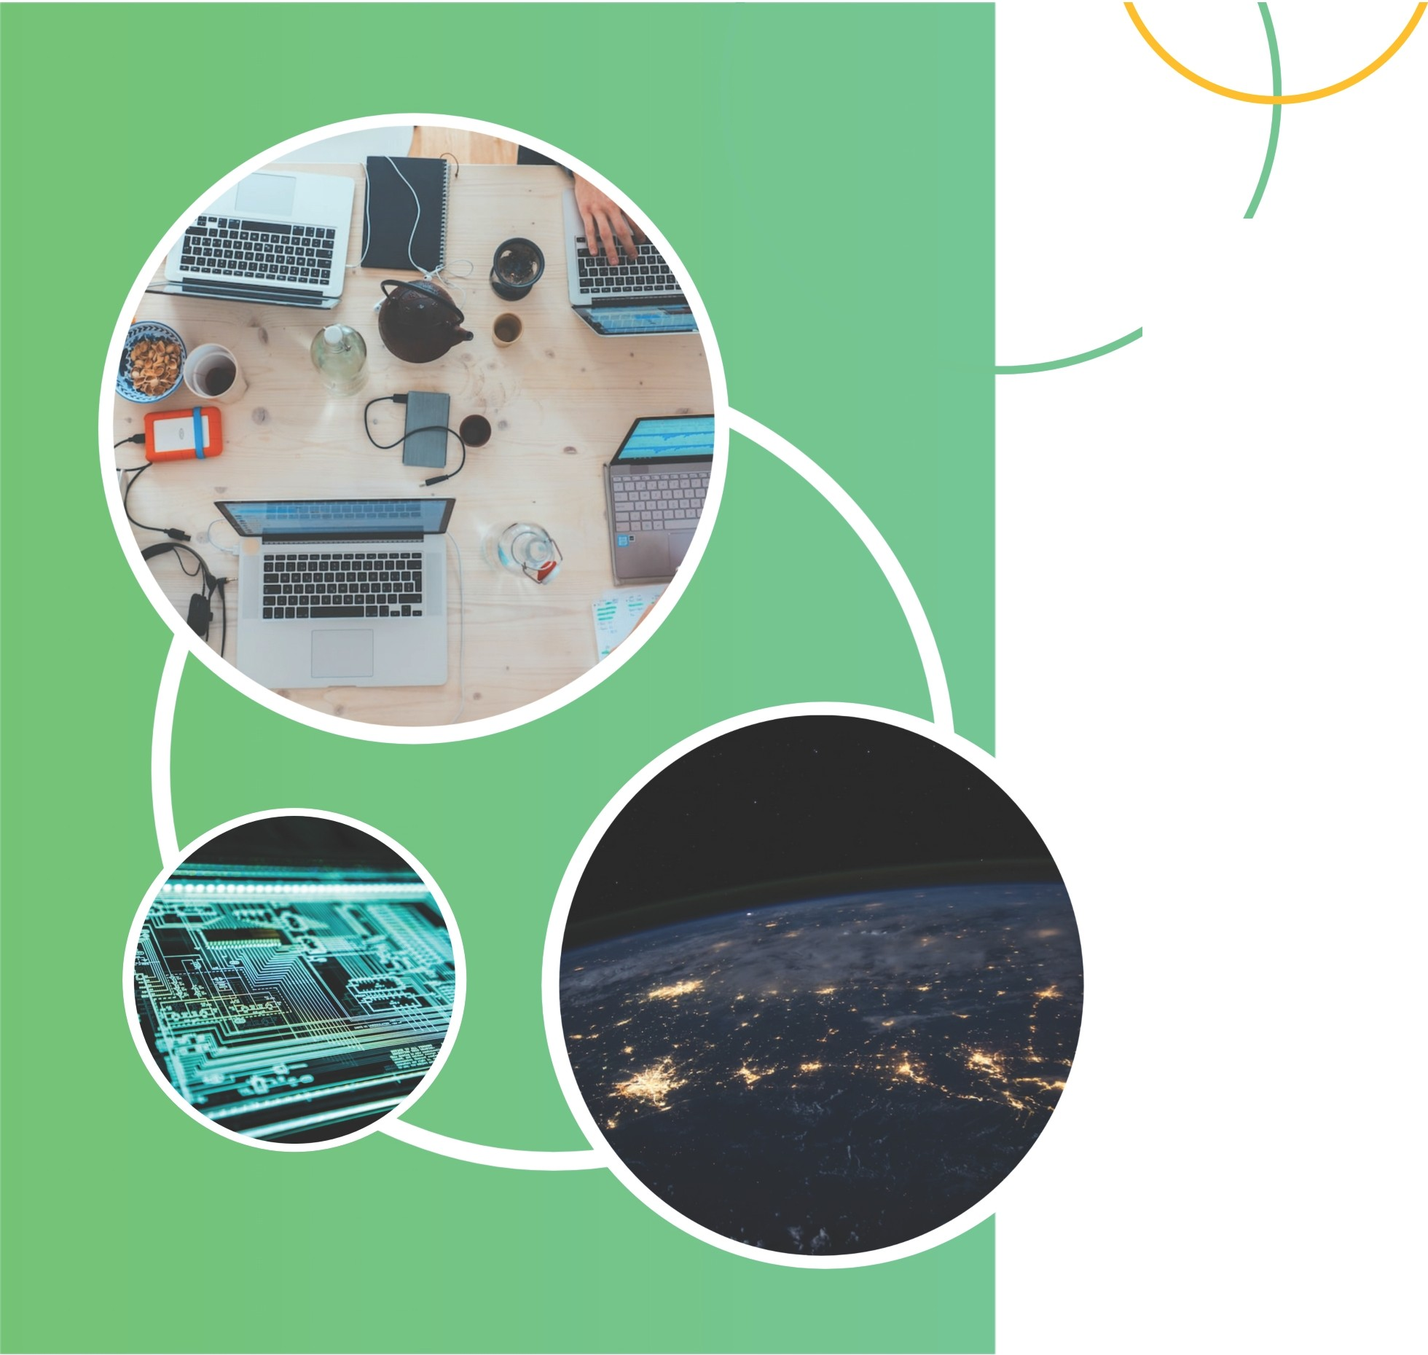
8. ETHICAL CONSIDERATIONS IN ARTIFICIAL INTELLIGENCE
AS AL BECOMES MORE ADVANCED AND INTEGRATED INTO OUR LIVES, IT RAISES IMPORTANT ETHICAL CONSIDERATIONS. QUESTIONS ARISE REGARDING PRIVACY, BIAS, AND THE POTENTIAL IMPACT ON JOBS
AND SOCIETY. IT IS CRUCIAL FOR DEVELOPERS, POLICYMAKERS, AND SOCIETY AS A WHOLE TO PRIORITIZE ETHICAL GUIDELINES AND ENSURE THAT AL TECHNOLOGIES ARE USED RESPONSIBLY AND FOR THE BENEFIT OF HUMANITY.

Slide 10
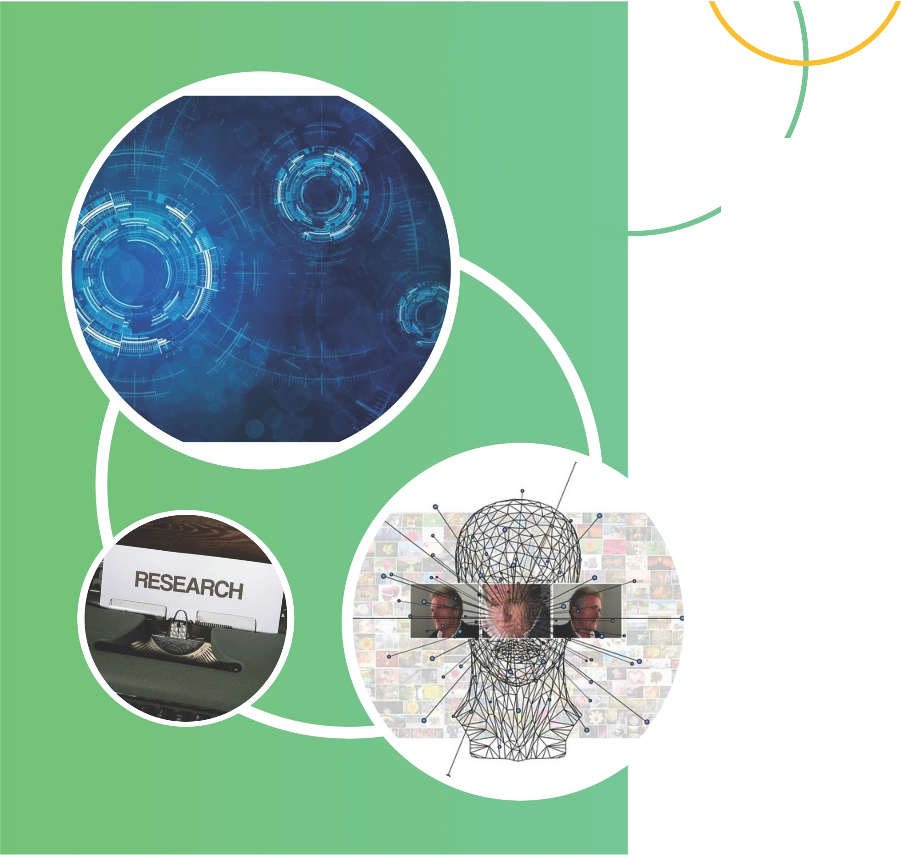
9.THE IMPACT OF ARTIFICIAL INTELLIGENCE ON INDUSTRIES
AS ARTIFICIAL INTELLIGENCE CONTINUES TO ADVANCE, ITS IMPACT ON INDUSTRIES IS PROFOUND. AL IS REVOLUTIONIZING SECTORS SUCH AS HEALTH CARE, FINANCE, TRANSPORTATION, AND MANUFACTURING BY ENHANCING EFFICIENCY, ACCURACY, AND AUTOMATION. HOWEVER, THIS ALSO MEANS POTENTIAL JOB DISPLACEMENT AND THE NEED FOR RESKILLING. IT IS CRUCIAL FOR BUSINESSES TO EMBRACE AL TECHNOLOGIES STRATEGICALLY AND ADAPT TO THE CHANGING LANDSCAPE TO STAY COMPETITIVE AND THRIVE.

Slide 11
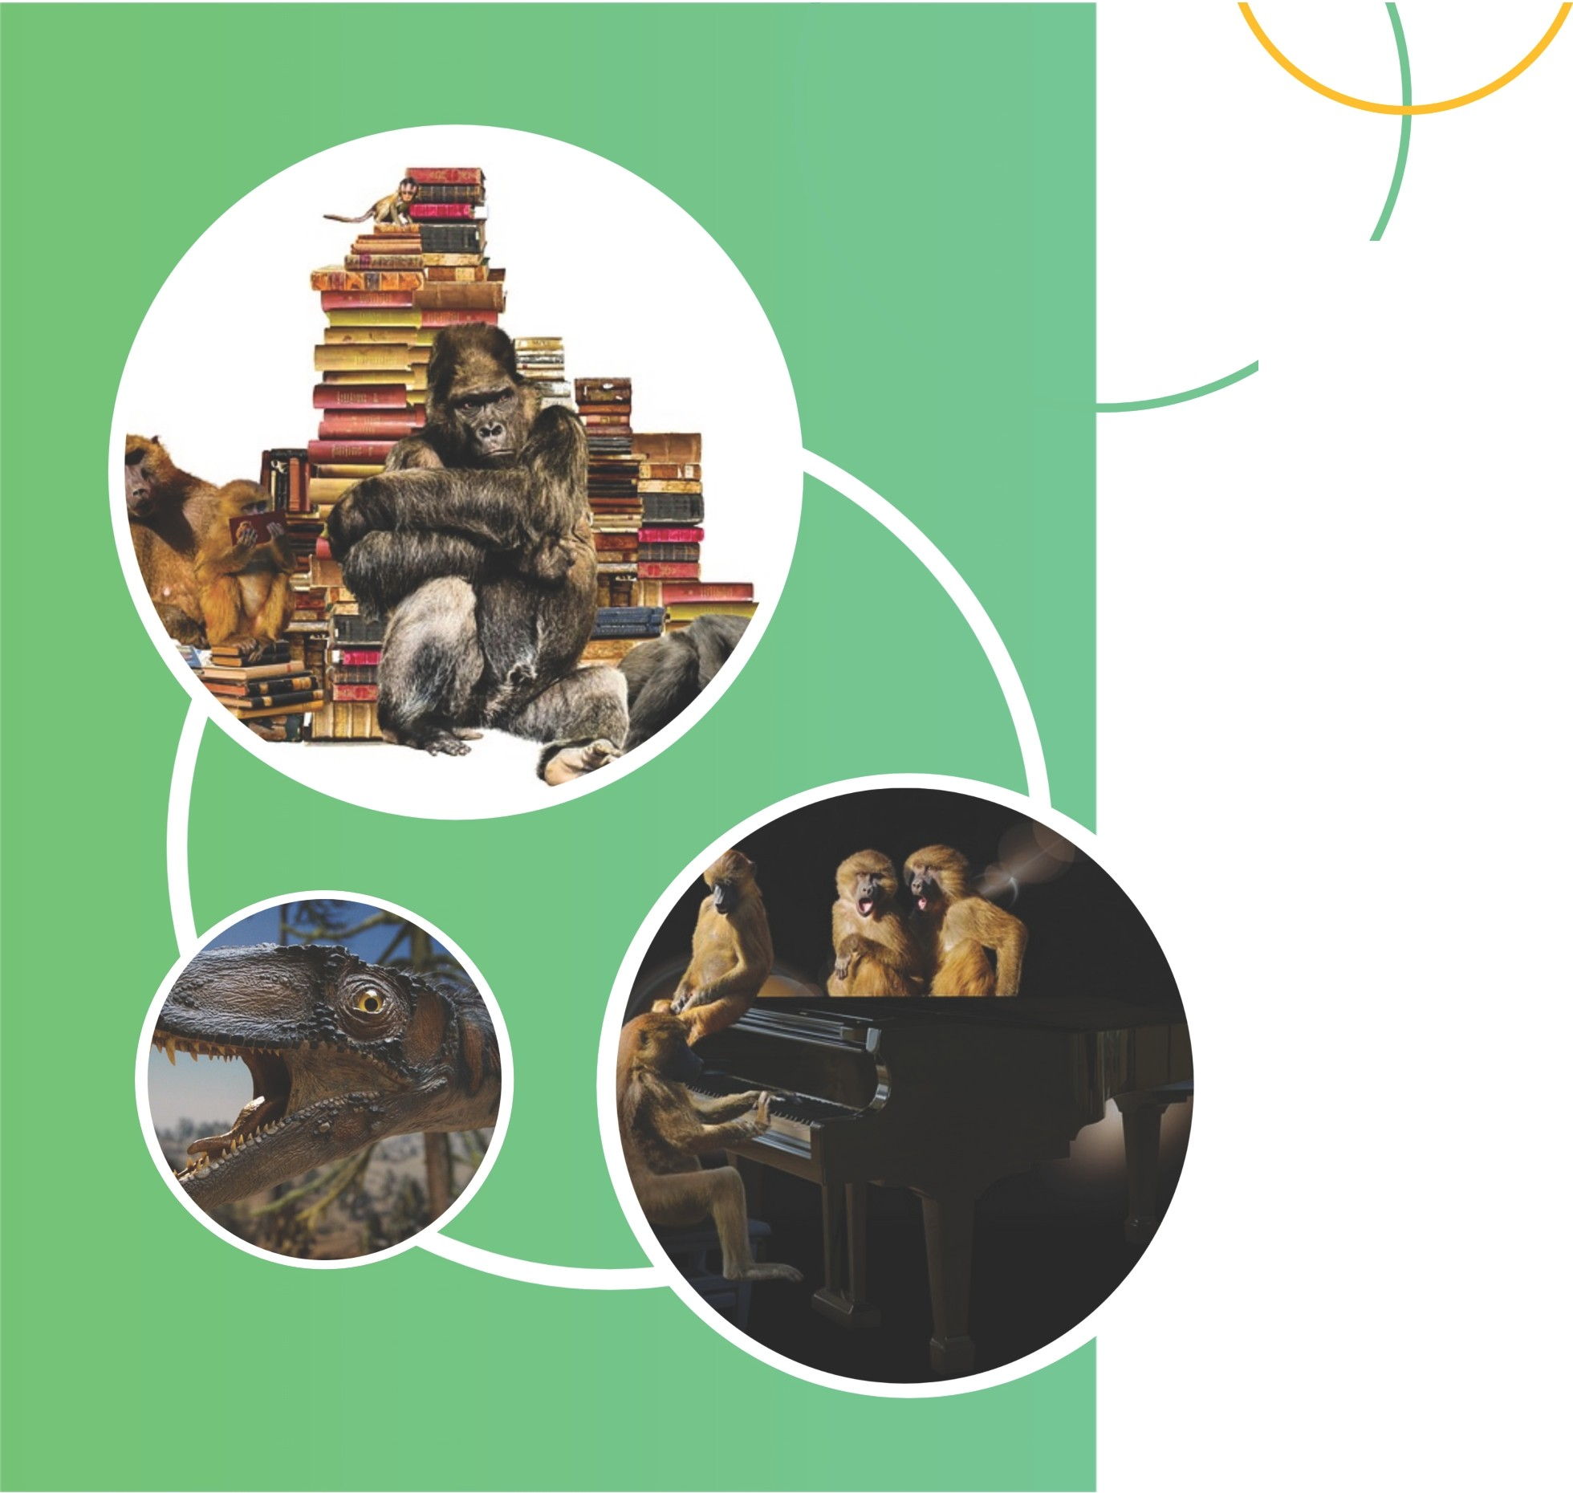
10. CURRENT APPLICATIONS AND FUTURE POSSIBILITIES
AL HAS ALREADY FOUND ITS WAY INTO VARIOUS SECTORS, INCLUDING CUSTOMER SERVICE, DATA ANALYSIS, AND VIRTUAL ASSISTANTS. IN THE FUTURE, AL HAS THE POTENTIAL TO REVOLUTIONIZE EVEN MORE INDUSTRIES, SUCH AS EDUCATION, AGRICULTURE, AND CYBERSECURITY. AS AL CONTINUES TO EVOLVE, THE POSSIBILITIES ARE ENDLESS, AND BUSINESSES NEED TO STAY AHEAD OF THE CURVE TO HARNESS ITS
FULL POTENTIAL AND REMAIN COMPETITIVE.

Slide 12
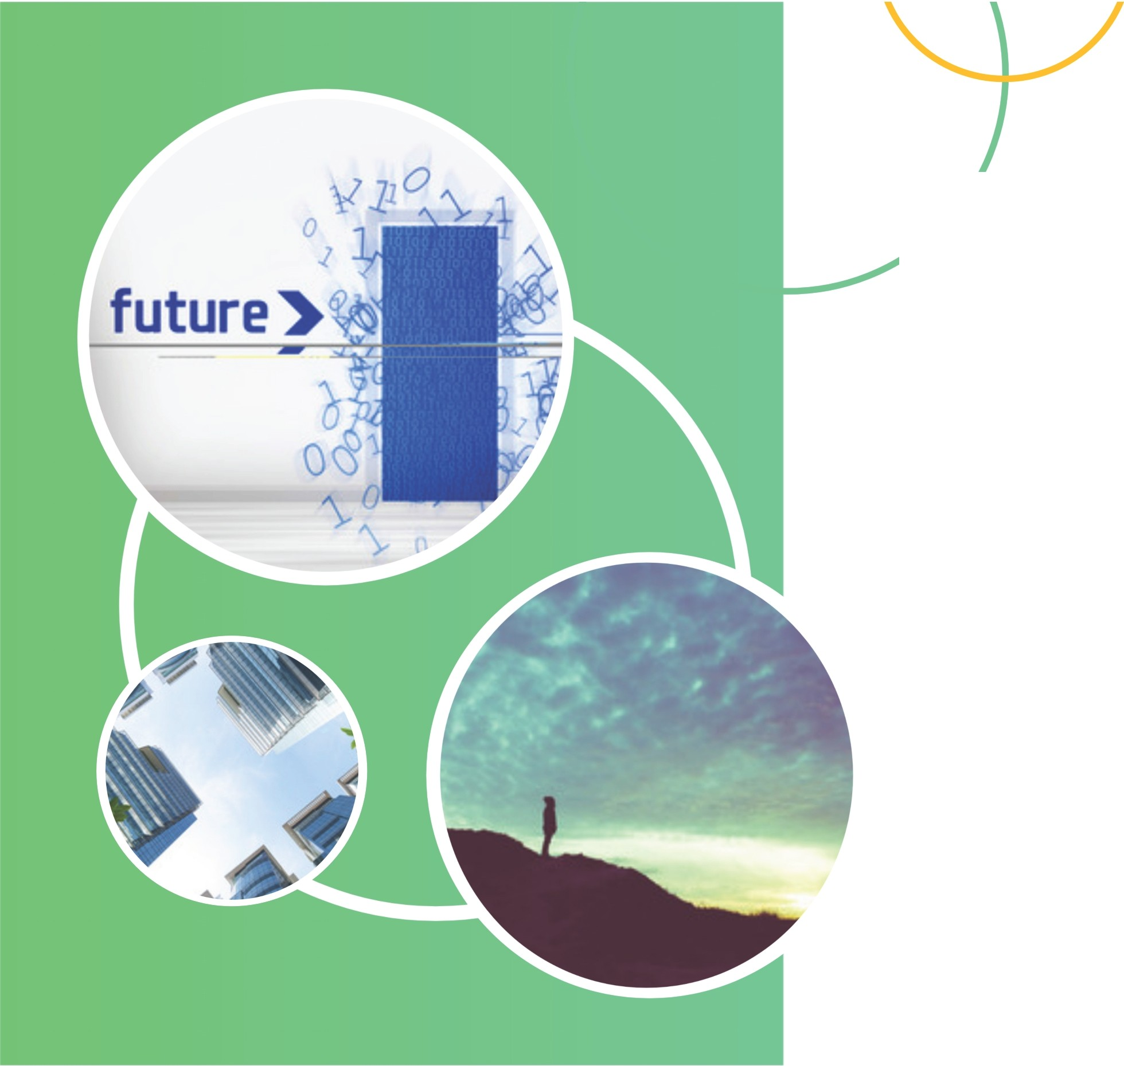
11. CHALLENGES AND LIMITATIONS OF ARTIFICIAL INTELLIGENCE
WHILE AL HAS INCREDIBLE POTENTIAL, THERE ARE SEVERAL CHALLENGES AND LIMITATIONS TO BE MINDFUL OF. ETHICAL CONCERNS REGARDING DATA PRIVACY AND MANIPULATION ARE AT THE FOREFRONT. AL ALSO F ACES LIMITATIONS IN UNDERSTANDING CONTEXT, SARCASM, AND HUMAN EMOTIONS. ADDITIONALLY, THERE IS THE RISK OF JOB DISPLACEMENT AS AL AUTOMATES CERTAIN TASKS. BY ADDRESSING THESE CHALLENGES, WE CAN ENSURE RESPONSIBLE AND BENEFICIAL INTEGRATION OF AL IN VARIOUS INDUSTRIES.

Slide 13
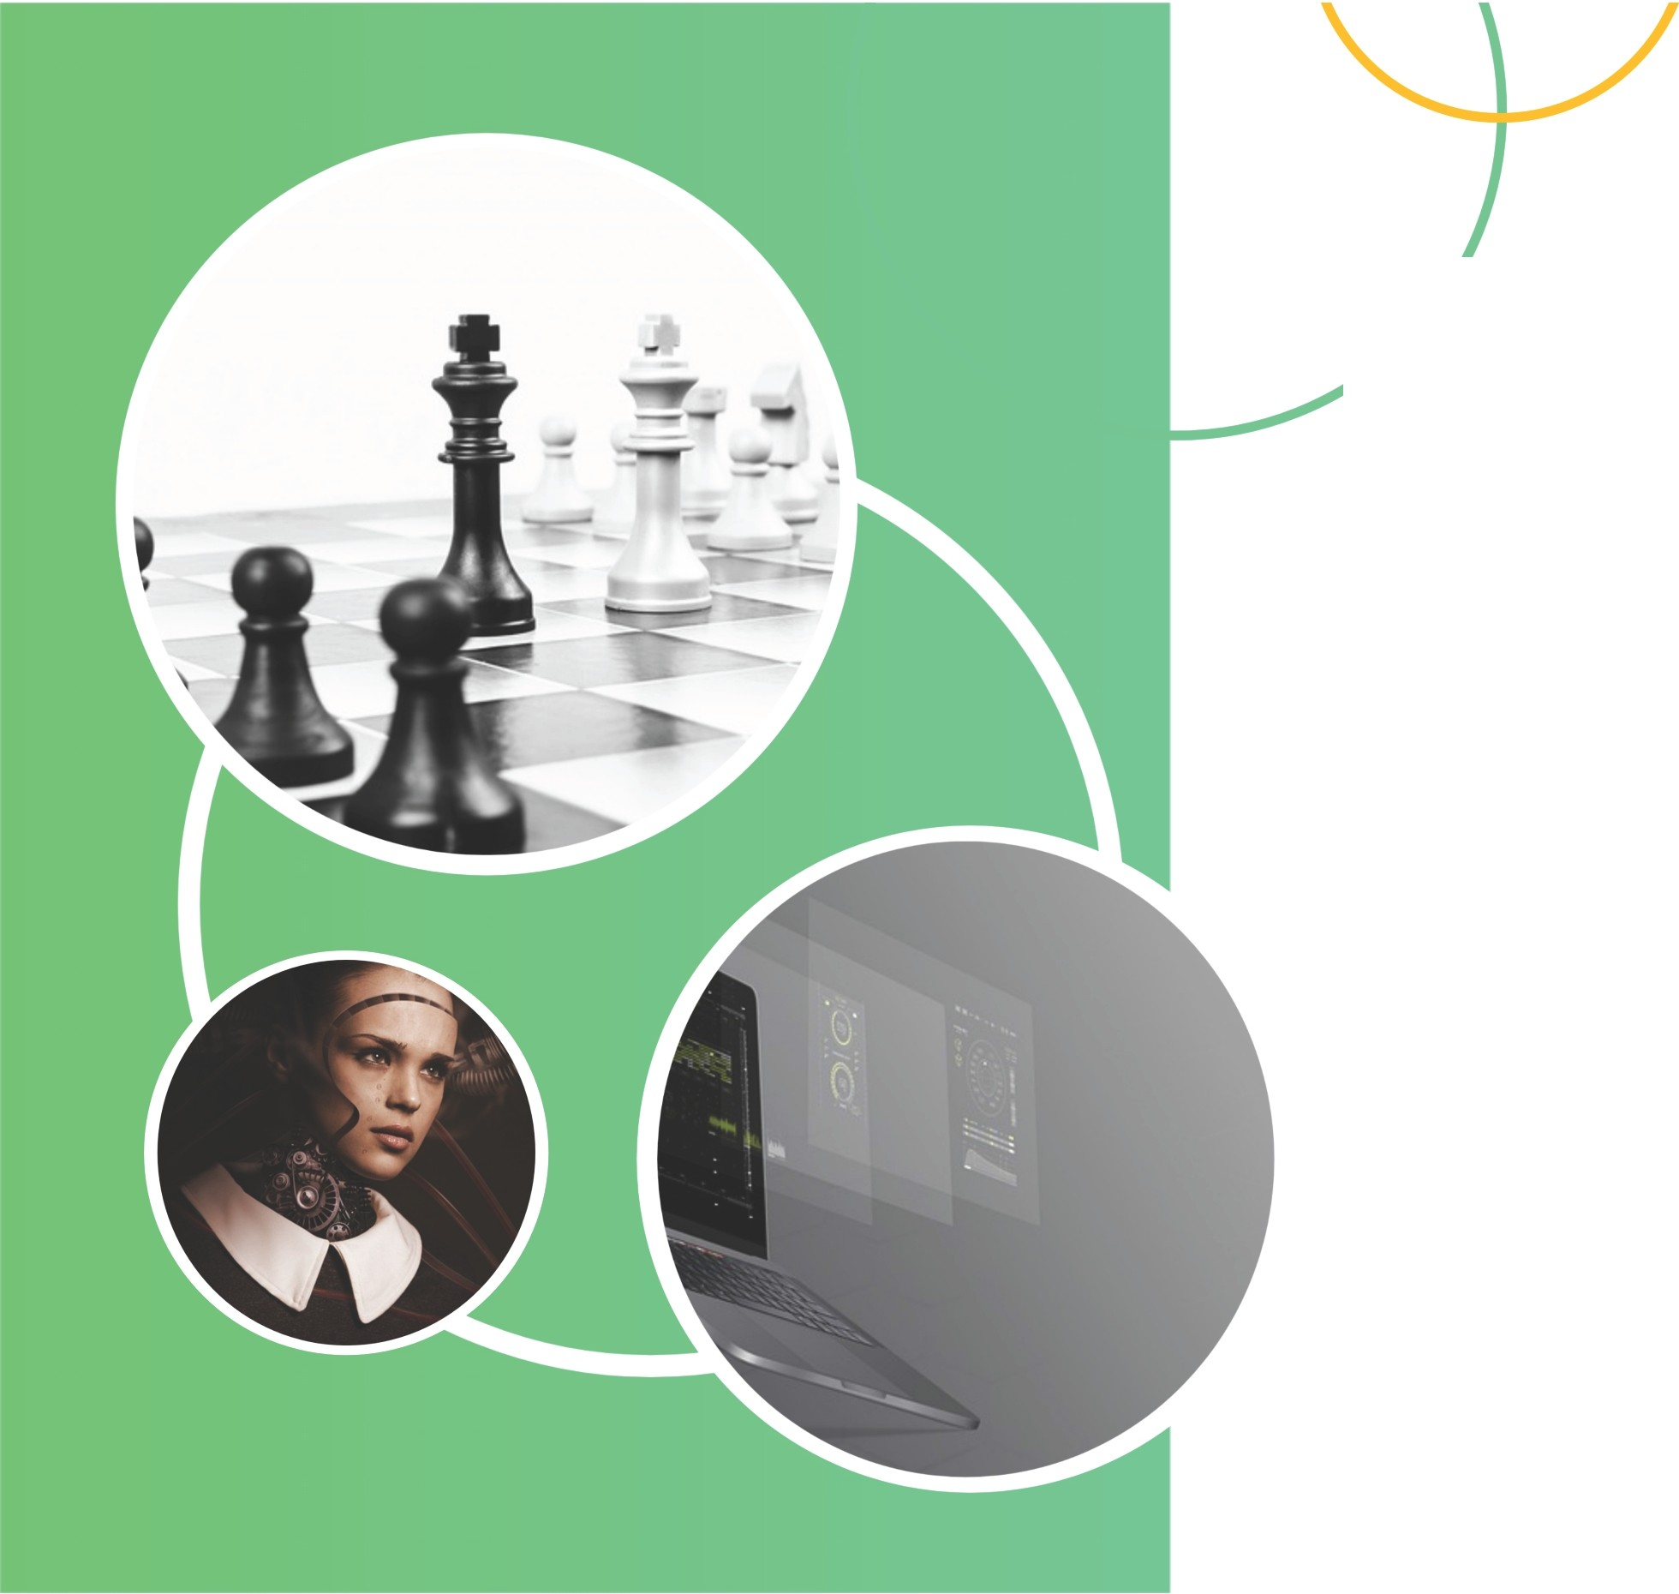
12. ARTIFICIAL GENERAL INTELLIGENCE:MYTH OR REALITY?
ARTIFICIAL GENERAL INTELLIGENCE (AGI) REFERS TO AL SYSTEMS THAT POSSESS THE ABILITY TO UNDERSTAND, LEARN,AND APPLY KNOWLEDGE IN A WAY THAT MATCHES OR SURPASSES HUMAN INTELLIGENCE. WHILE AGI REMAINS AN ONGOING TOPIC OF DEBATE, EXPERTS BELIEVE THAT ACHIEVING TRUE AGI IS COMPLEX AND MAY TAKE YEARS OR EVEN DECADES OF RESEARCH AND DEVELOPMENT. IT IS CRUCIAL TO UNDERSTAND THE CURRENT LIMITATIONS AND CHALLENGES IN ORDER TO SET REALISTIC EXPECTATIONS FOR AL’S
FUTURE CAPABILITIES.

Slide 14
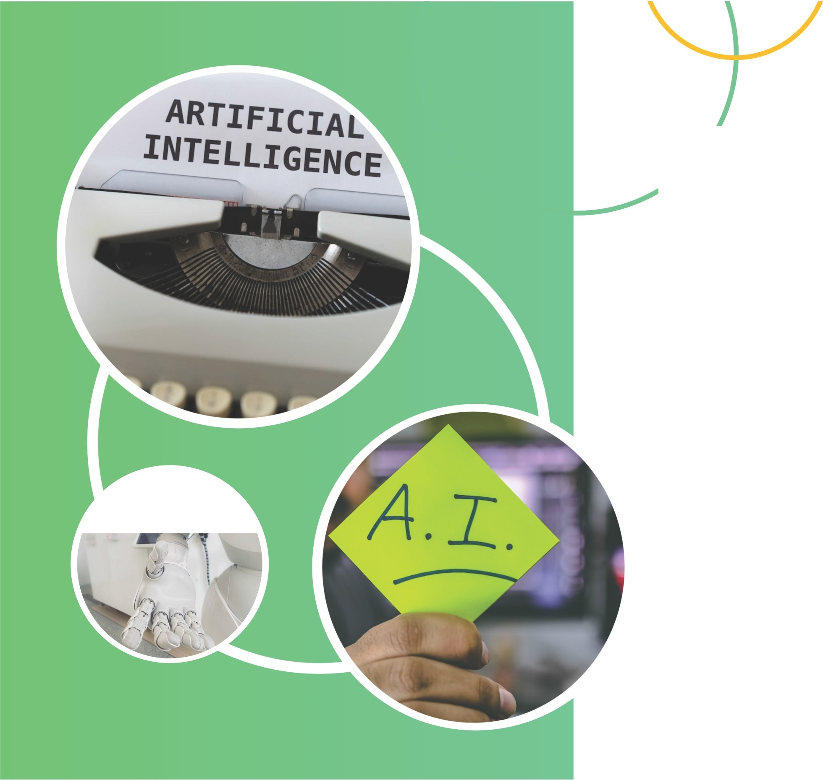
13. The Role of Human-Centric Al
AS WE EXPLORE THE EVOLUTION OF AL, IT IS CRUCIAL TO EMPHASIZE THE IMPORTANCE OF HUMAN-CENTRIC AL. THIS APPROACH F OCUSES ON HARNESSING AL'S CAPABILITIES TO ENHANCE AND AUGMENT HUMAN ABILITIES, RATHER THAN REPLACING HUMANS ENTIRELY. BY PRIORITIZING ETHICAL CONSIDERATIONS, PRIVACY, AND INCLUSIVITY, WE CAN ENSURE AL SERVES AS A POWERFUL TOOL THAT COLLABORATES
WITH HUMANS, ULTIMATELY LEADING TO A MORE SUSTAINABLE AND BENEFICIAL FUTURE FOR ALL.

Slide 15
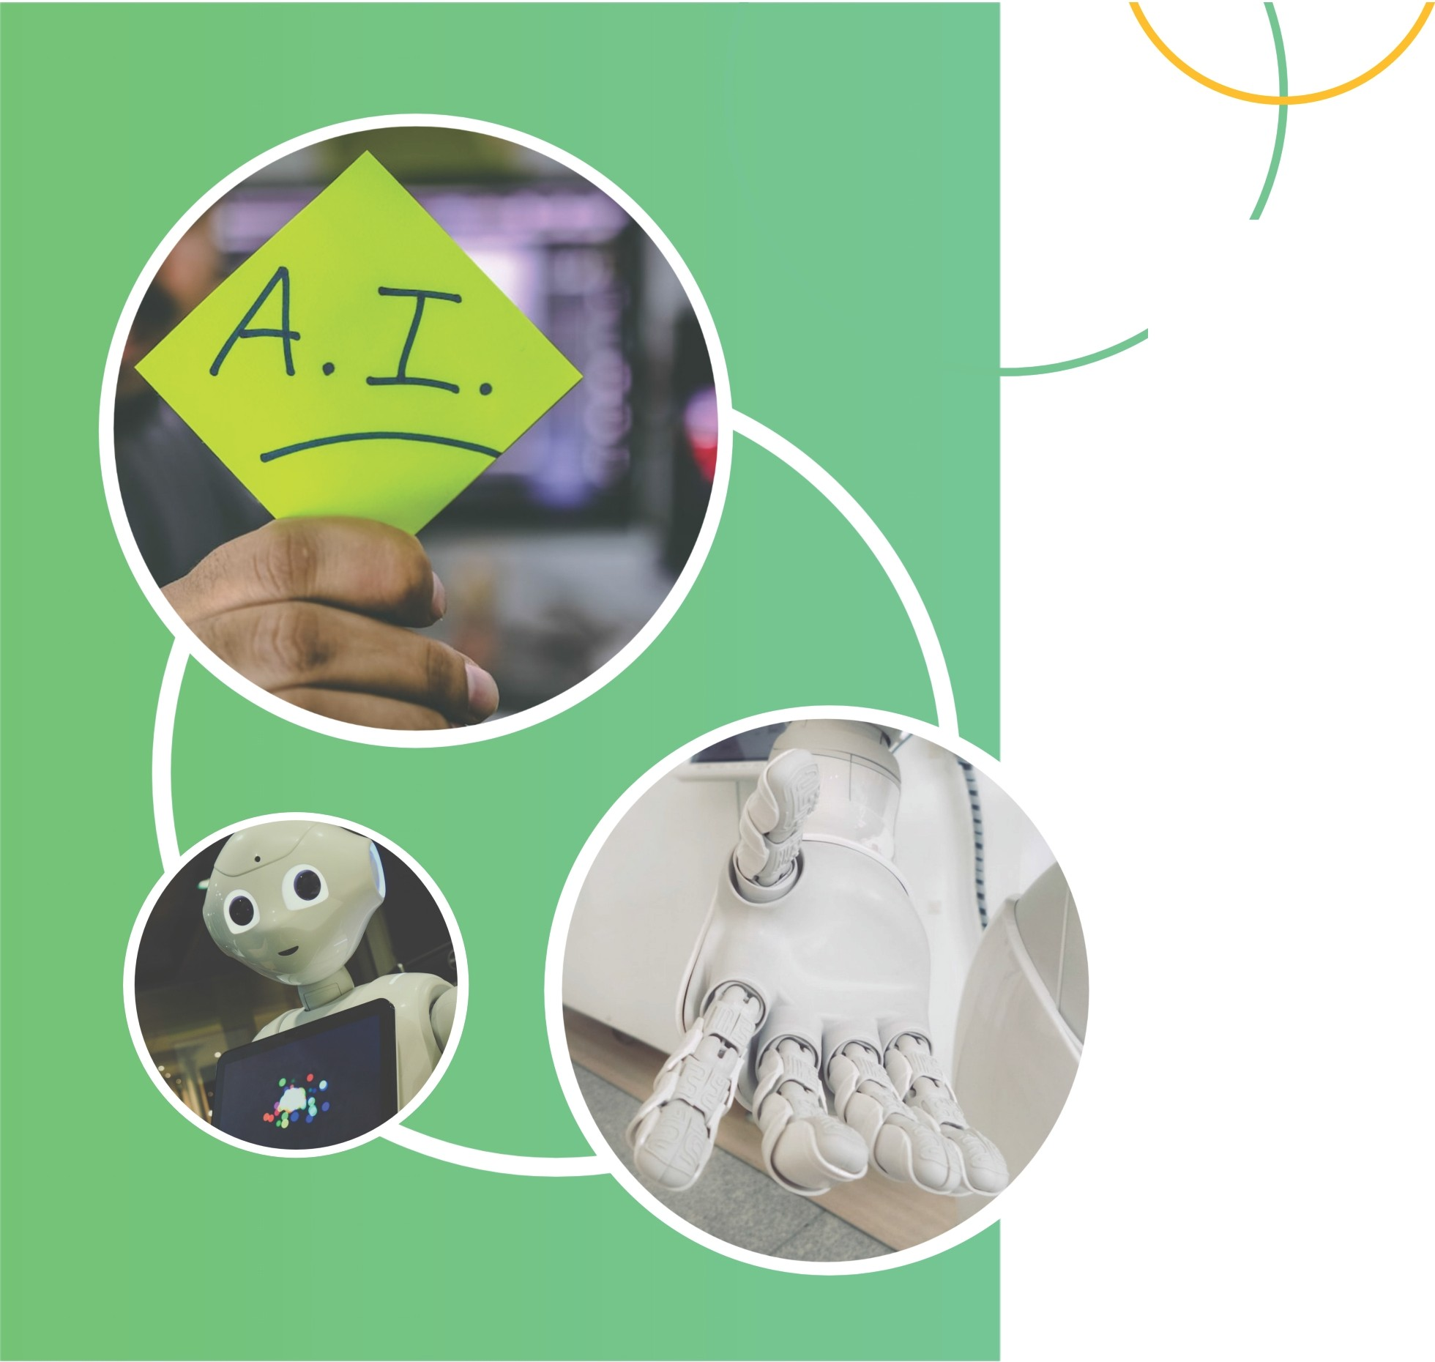
14. CONCLUSION - THE FUTURE OF ARTIFICIAL INTELLIGENCE
WITH THE RAPID ADVANCEMENT OF AL,THE FUTURE HOLDS IMMENSE POTENTIAL. BY EMBRACING HUMAN-CENTRIC AL,WE CAN ACHIEVE
A HARMONIOUS COLLABORATION BETWEEN HUMANS AND MACHINES. THROUGH ETHICAL CONSIDERATIONS, PRIVACY
PROTECTION,AND INCLUSIVITY, WE CAN CREATE A FUTURE WHERE AL ENHANCES OUR LIVES, AMPLIFIES OUR CAPABILITIES, AND ADDRESSES COMPLEX CHALLENGES. LET US EMBRACE THIS EXCITING ERA OF AL WITH RESPONSIBILITY AND A VISION FOR A BETTER TOMORROW.

Slide 16
THANKS

